Slide 1

Final Project ML Regression Treatment Charges Prediction
IBM Machine Learning Professional Certificate
Course 02: Supervised Machine Learning: Regression
By Mohamad Osman

Slide 2

Contents
Dataset Description
Main objectives of the analysis.
Applying various regression models.
Machine learning analysis and findings.
Models flaws and advanced steps.

Slide 3
Data Description Section

Slide 4
Introduction
Today we will explore and work on a dataset dedicated to the cost of treatment of different patients. The cost of treatment depends on many factors: diagnosis, type of clinic, city of residence, age and so on. We have no data on the diagnosis of patients. But we have other information that can help us to make a conclusion about the health of patients and practice regression analysis to create a predictive model capable of predicting the charges of insurance depending on the patient features. In any case, I wish you to be healthy! Let's look at our data.

Slide 5
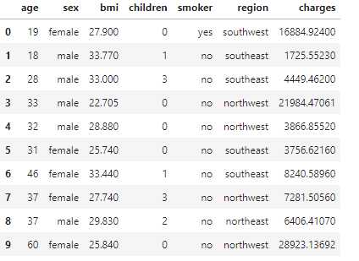
Dataset Description 01
Features:
age: age of customer | patient
sex: male-female
bmi: body mass index
children: number of children
Smoker: smoking or not smoking
region: residential area
charges: treatment charges

Slide 6
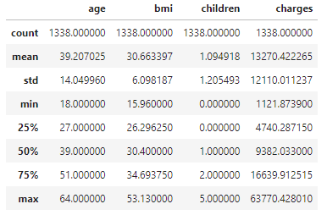


Dataset Description 02
Mean:
Age : 39
Bmi : 30.6
Children: 1
Charges : 13270$
Min:
Age : 18
Bmi : 15.96
Children: 0
Charges : 1121.87$
Max:
Age : 64
Bmi : 53.13
Children: 5
Charges : 63770.43$

Slide 7
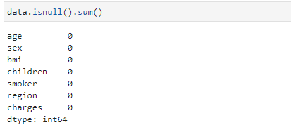

Dataset Description 03
Great, there is no missing values within our features !

Slide 8
Data Analysis Section

Slide 9
Main Objective of the analysis:
In this section I am showing the correlation between features to find the most influence feature on our target which is insurance charges.
Furthermore, I am studying the normality of the features through techniques such as square root, Log Transformation, Box cox Transformation
After that I am building different regression models based on advanced techniques such as GridSearch , ML pipelines, and Hyperparameters tuning to get the best predictive model in terms of accuracy and to sho what are the flaws of each model.

Slide 10
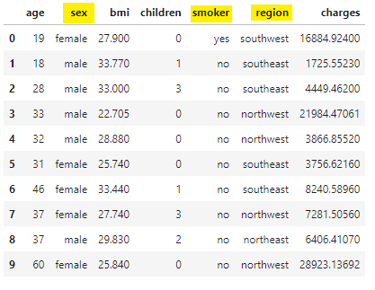
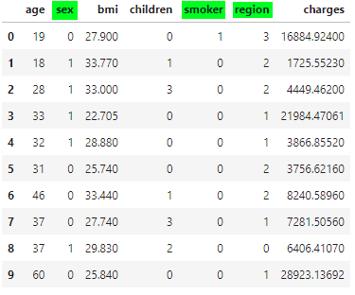
Data Analysis & Cleaning 01
- Converting categorical features into numerical features

Slide 11
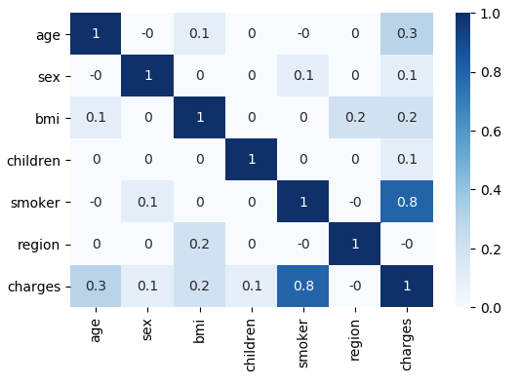
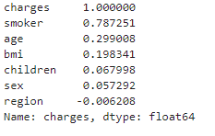
Data Analysis & Cleaning 02
- Studying the correlations between features using Heat Map!
We can notice that the strongest correlation is between “smoker” feature
and our target “charges”. Where the feature does not affect our target
at all is “region” which will be dropped from our dataset

Slide 12
Determining Normality 01
Making our target variable normally distributed often will lead to better results
If our target is not normally distributed, we can apply a transformation to it and then fit our regression to predict the transformed values.
How can we tell if our target is normally distributed? There are two ways:
1- checking the visual distribution of the data.
2- calculating the P-value.

Slide 13
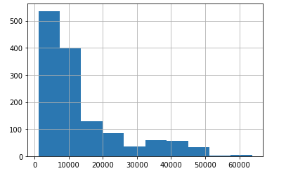
Determining Normality 02
Normality Visualization
Normal test Result
statistic = 336.8851220567733
p-value = 7.019807901276e-74

Slide 14
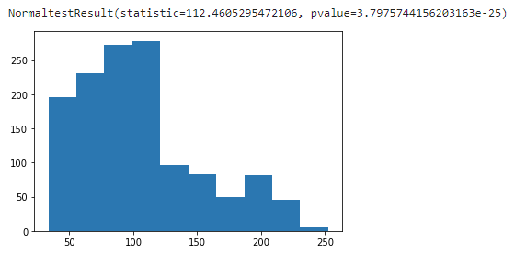
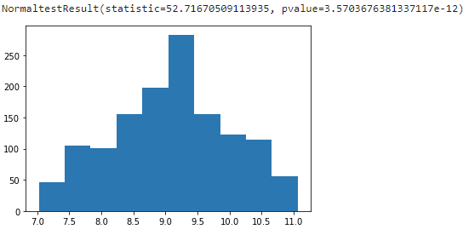
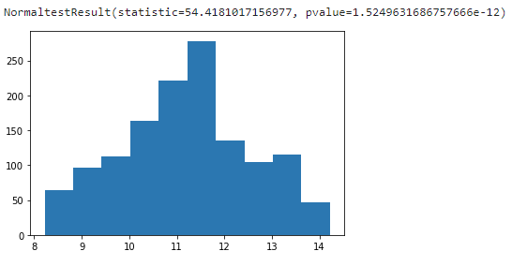
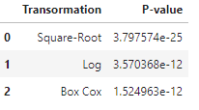
Determining Normality 03
Square root Log Transformation Box cox Transformation
As shown in the table on the right there is no big difference between log & Box Cox transformations so for the sake of simplicity, we can go with Log transformation! To make our target distribution more normalized!

Slide 15
Machine Learning Analysis & Findings

Slide 16
Machine Learning Analysis & Findings
In the following analysis will compare between 4 different regression models Vanilla, Lasso, Ridge, and ElasticNet in terms to their accuracy in predicting the charges of treatment for patients. Where I am going to use the following techniques to help me in developing robust models:
Standard scaling, Polynomial effects, Regularization regression, cross-validation method, Grid Search, metric measurements such RMS and R2 Score.

Slide 17
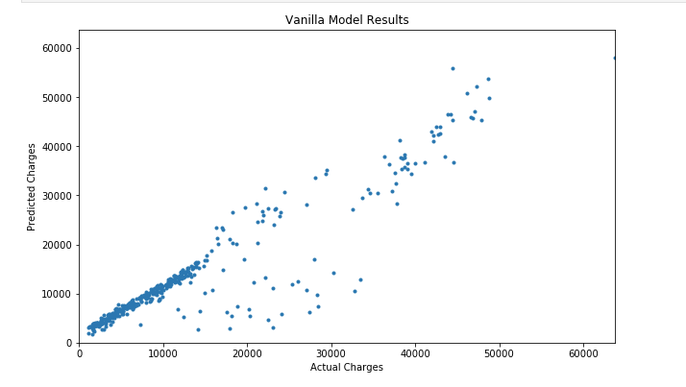
Machine Learning Analysis 01
Vanilla Regression Model:
Model Features and Parameters:
Model = LinearRegression()
Polynomial Features degree = 2
Standard Scalar
RMS_score | R2_Score
4496.560110896 | 0.862102995

Slide 18
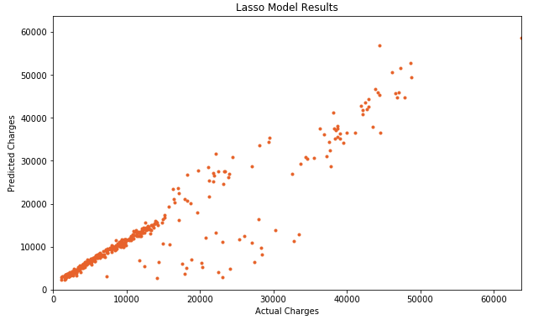
Machine Learning Analysis 02
Lasso Regression Model:
Model Features and Parameters:
Model = Lasso()
Polynomial Features degree = 2
Standard Scalar
Alpha = 13.7454
max_iter = 10000
RMS_score | R2_Score
4496.577651935 | 0.862101919

Slide 19
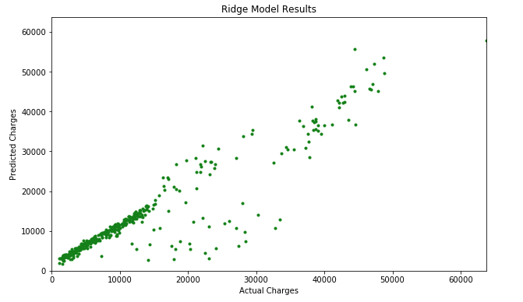
Machine Learning Analysis 03
Ridge Regression Model:
Model Features and Parameters:
Model = Ridge()
Polynomial Features degree = 2
Standard Scalar
Alpha = 0.55974
max_iter = 10000
RMS_score | R2_Score
4494.682979659 | 0.862218104

Slide 20
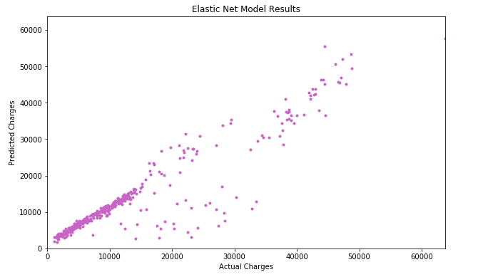
Machine Learning Analysis 04
ElasticNet Regression Model:
Model Features and Parameters:
Model = ElasticNet()
Polynomial Features degree = 2
Standard Scalar
Alpha = 0.008111
L1 ratio = 0.9
max_iter = 10000
RMS_score | R2_Score
4494.417700642 | 0.862218104

Slide 21
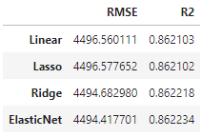
Machine Learning Analysis 05
Models Comparison
As shown in the data frame all the models provide very good
prediction results and these results are so close to each other,
But at the end we must choose one model for our dataset
and this depends on the highest result.
Below I ordered the models descending:
1- ElasticNet
2- Ridge
3- Vanilla Linear
4- Lasso

Slide 22
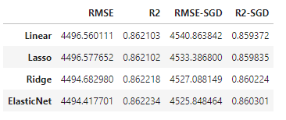
Machine Learning Analysis 06
Adding regularization terms:
Let’s add regularization terms to our models and check how this will affect our results!
As shown above we ended up with worst results ☹ so we can be satisfied with old models and
Choose Elastic Net as highest accuracy model in terms of prediction the charges of treatment.

Slide 23
Models flaws and strengths and advanced steps

Slide 24
Machine Learning Analysis 07
Models Flaws and Strength and further suggestions:
In terms of simplicity, we can say vanilla linear regression provided high predictive results and the simplest and fastest Model in terms of parameters but if we look to other models Lasso, Ridge and ElasticNet they provided higher results but in they were more complex and slower since when we used grid search technique to search about best fitting parameters, they took longer time so at the end it is a tradeoff if we have bigger dataset then the performance will be higher with these models, but the training process will take a longer time where if we choose vanilla model will relatively sacrifice by some accuracy but the training process will be much faster.

Slide 25
Thank you
IBM Machine Learning Professional Certificate
Supervised Machine Learning: Regression
By: Mohamad Osman

